Slide 1

🎮 PlayStation Sales and Ratings Analysis Project Presentation Guide
Project Overview & Goal (S
Project Title: PlayStation Sales and Ratings Analysis (PS3, PS4, PS5)
Goal: The primary goal was to analyze sales distribution, regional performance, and the relationship between game ratings (user and critic) and commercial success across the PS3, PS4, and PS5 console generations.

Slide 2
Data Cleaning & Preparation
Key Preparation Steps:
Column Cleaning
Data Types
Standardized column names (e.g., total_sales, release_year).
Converted the release_date column to datetime and extracted a usable release_year.
Missing Values
Duplicates
Handled missing data by filling:
Confirmed 0 duplicate entries in the final dataset.
rating with 0 (for unrated games).
genres with "Unknown".
release_year with "Unknown" (and converted valid entries to integers).

Slide 3
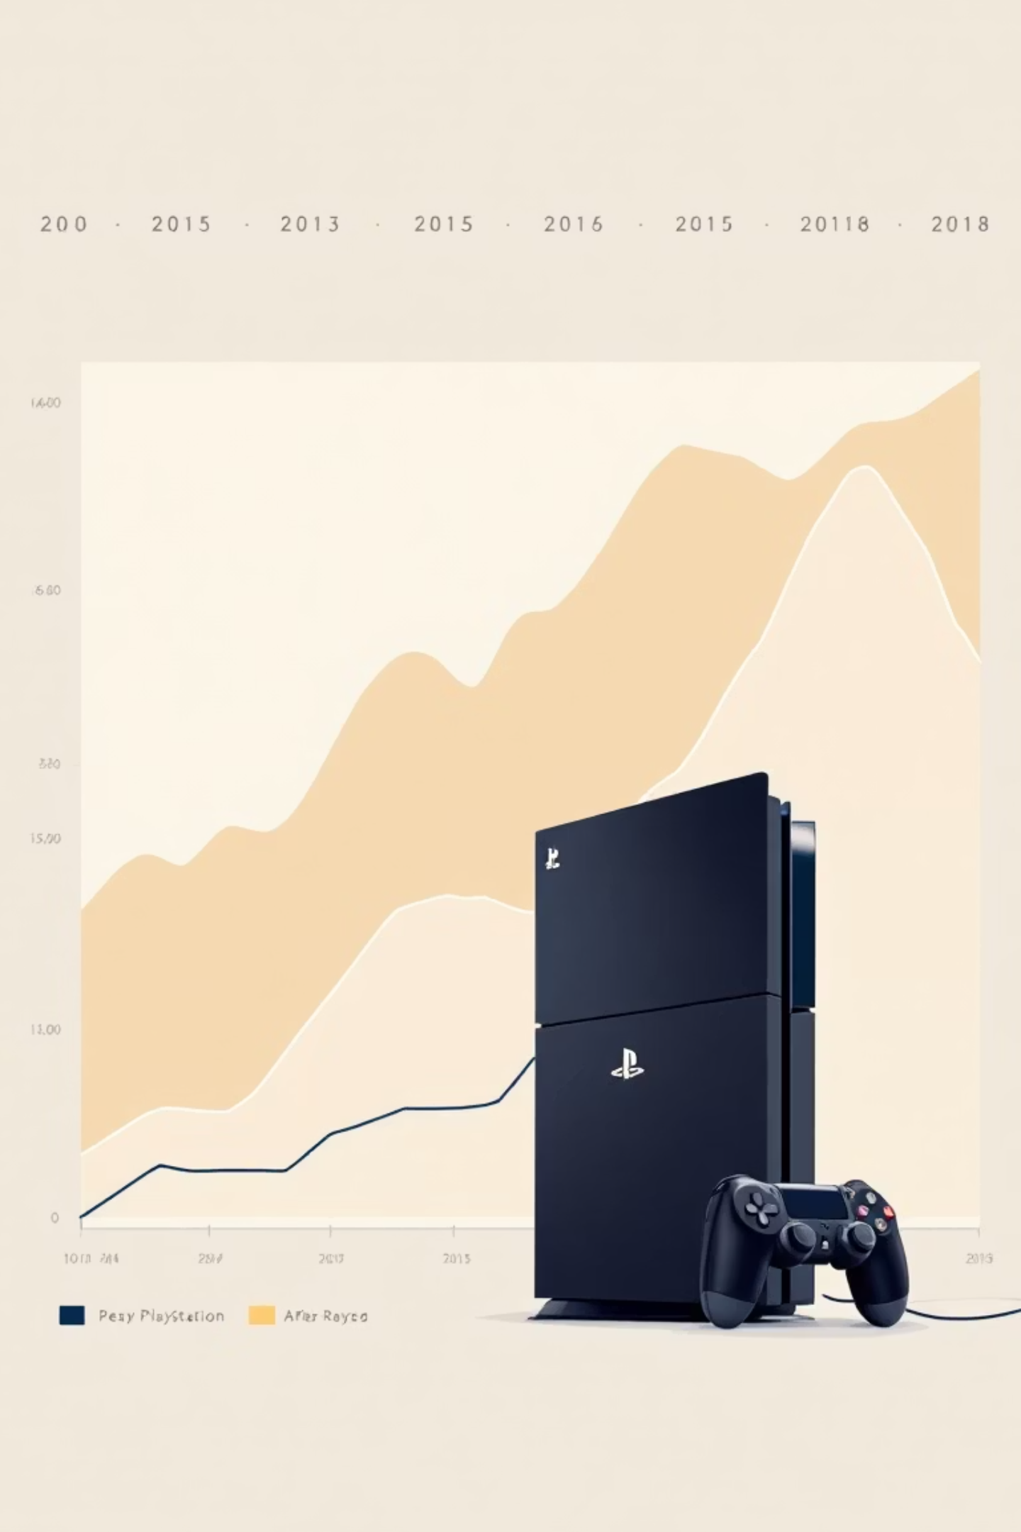
Key Findings & Insights
📈 Console & Trend Analysis
Console Sales:
Sales Over Time:
PS4 generated the highest total sales, followed by PS3 and PS5.
Total sales peaked dramatically between 2013 and 2015, correlating directly with the PS4's launch and early success.
Self-Correction/Limitation: Noted that many PS5 entries had zero sales data recorded in the dataset, which artificially suppresses its total sales figure, so PS4's lead is expected due to its longer, complete lifecycle.
Sales remained strong through 2017, indicating a long, successful lifecycle for the PS4.
Sales declined sharply after 2018, largely due to missing or incomplete data for newer PS5 titles in the dataset.

Slide 4
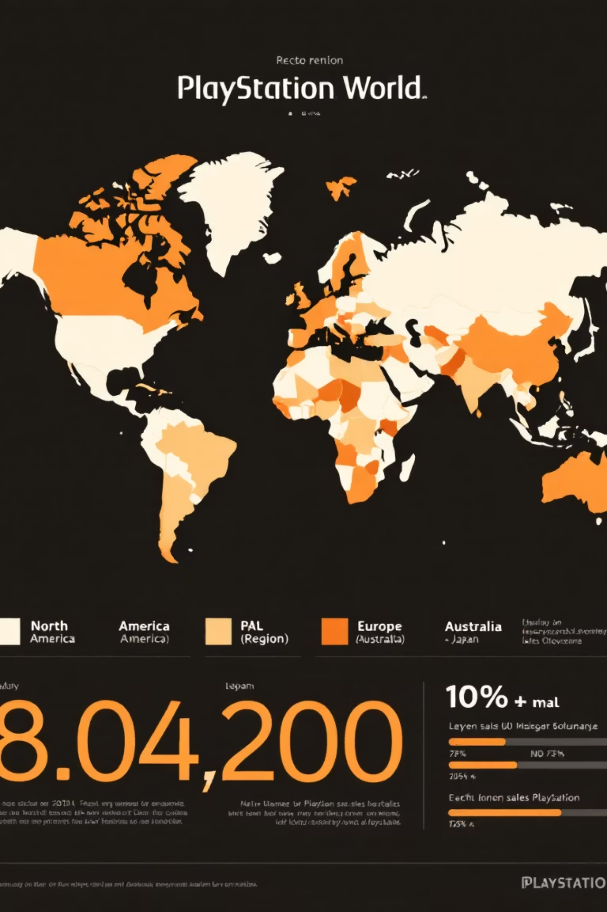

🌍 Regional Performance
North America (NA)
PAL Region
Is the largest market for PlayStation games in the dataset.
(Europe, Australia, etc.) is the second largest contributor.
Japan Sales
Are noticeably lower than both NA and PAL, suggesting different market dynamics or game preferences.

Slide 5
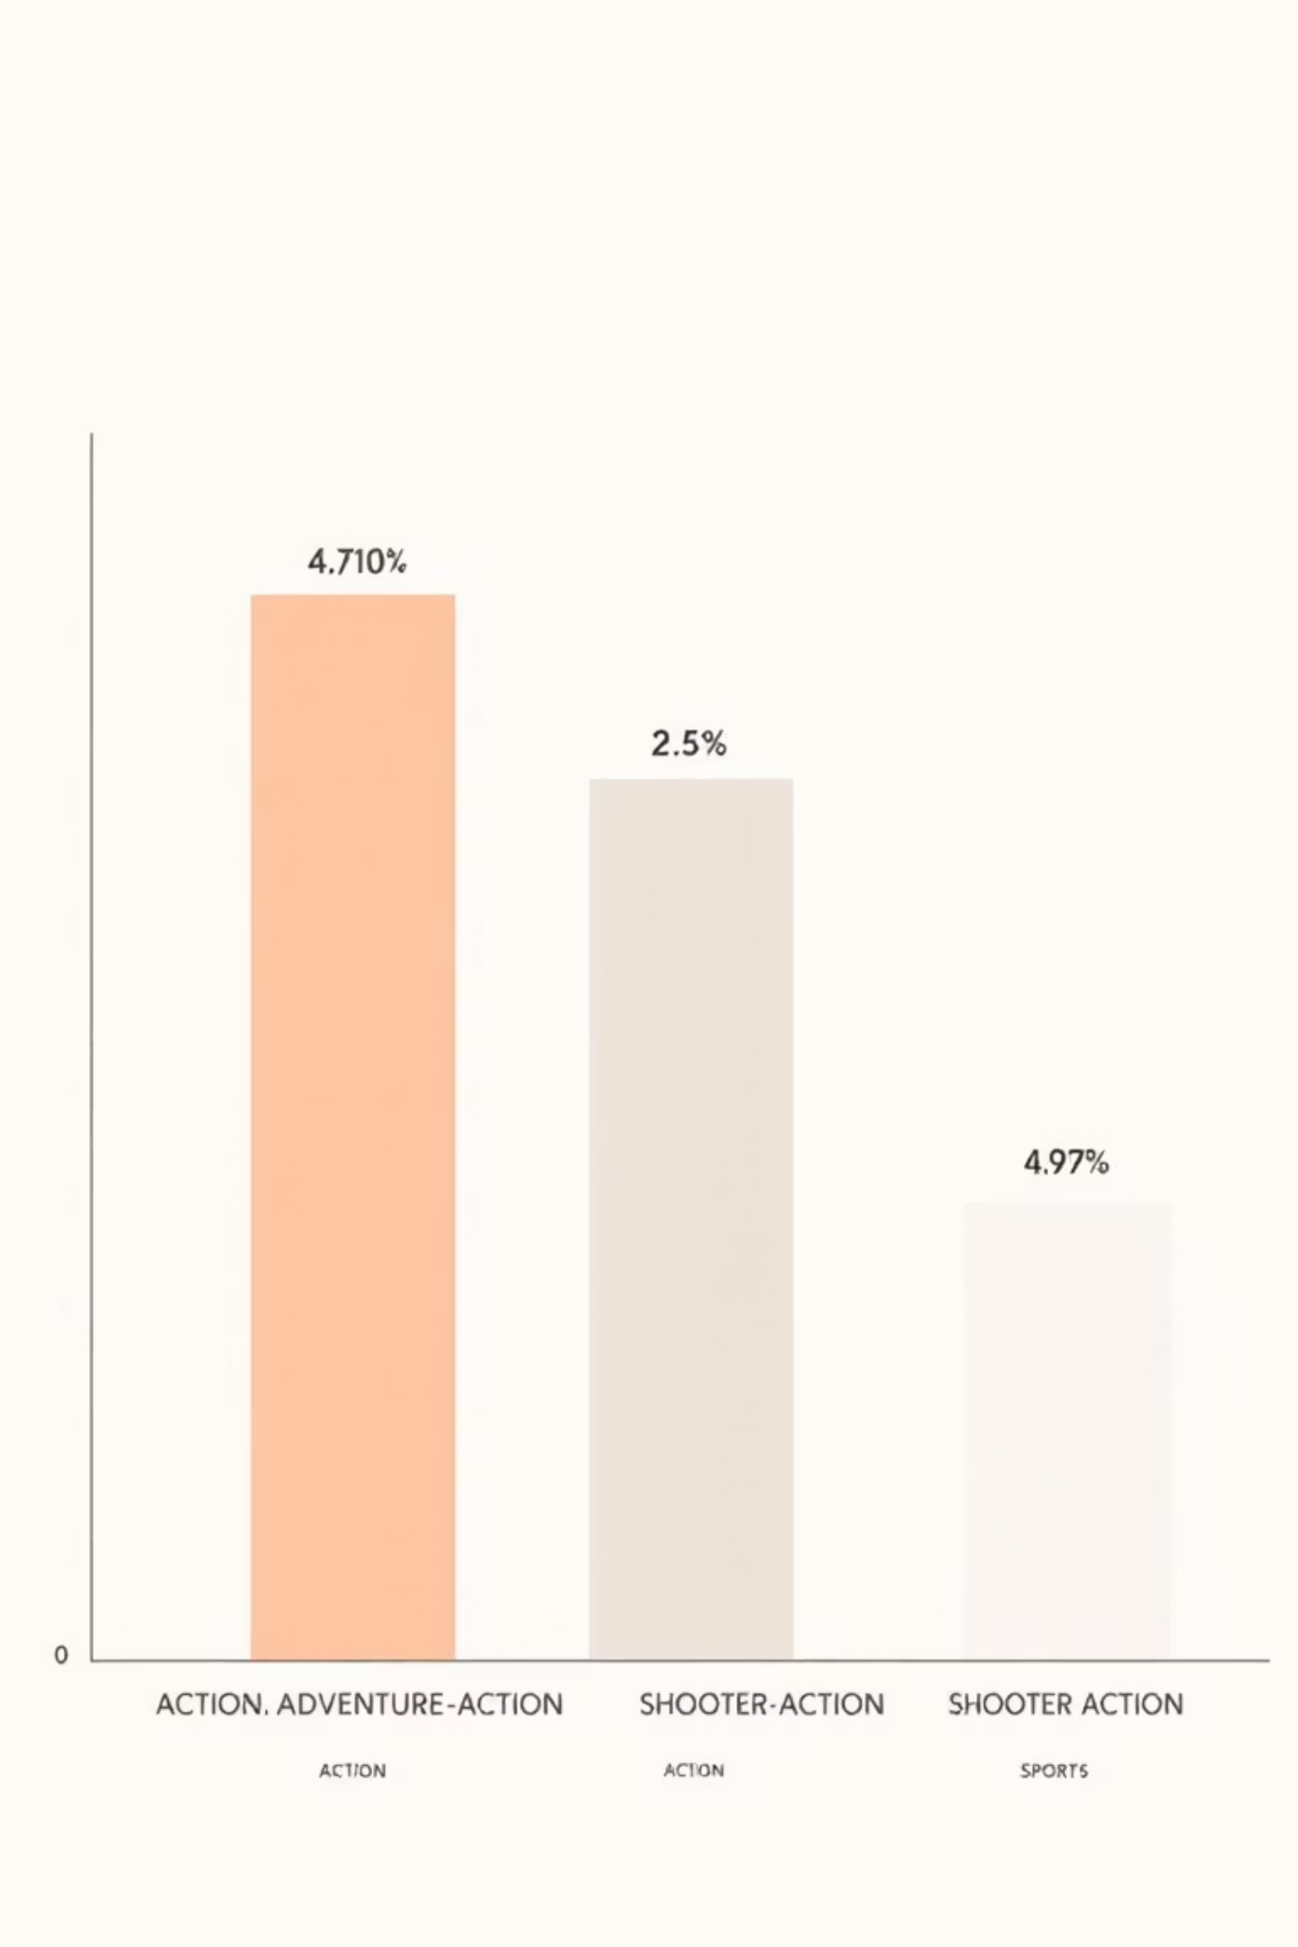
🏷️ Genre Popularity
After accounting for the "Unknown" category:
Action
The most prevalent genre.
Adventure-Action
Followed by Adventure-Action.
Shooter-Action
Followed by Shooter-Action.
Sports
And Sports.
Insight: Action-oriented games dominate the PlayStation library across all three generations.

Slide 6

📉 User & Critic Ratings Correlation
Overall Relationship: Both User Ratings (rating) and Critic Scores (metacritic) show a weak correlation with total_sales.
* * Key Observations (Visual Evidence):
Many highly rated games (4.0+ or 80+ Metacritic) still have moderate to low sales.
A few low-rated/unrated games managed to achieve very high sales (e.g., in the lower sales range of your scatter plots), suggesting marketing or franchise loyalty can sometimes outweigh quality scores

Slide 7
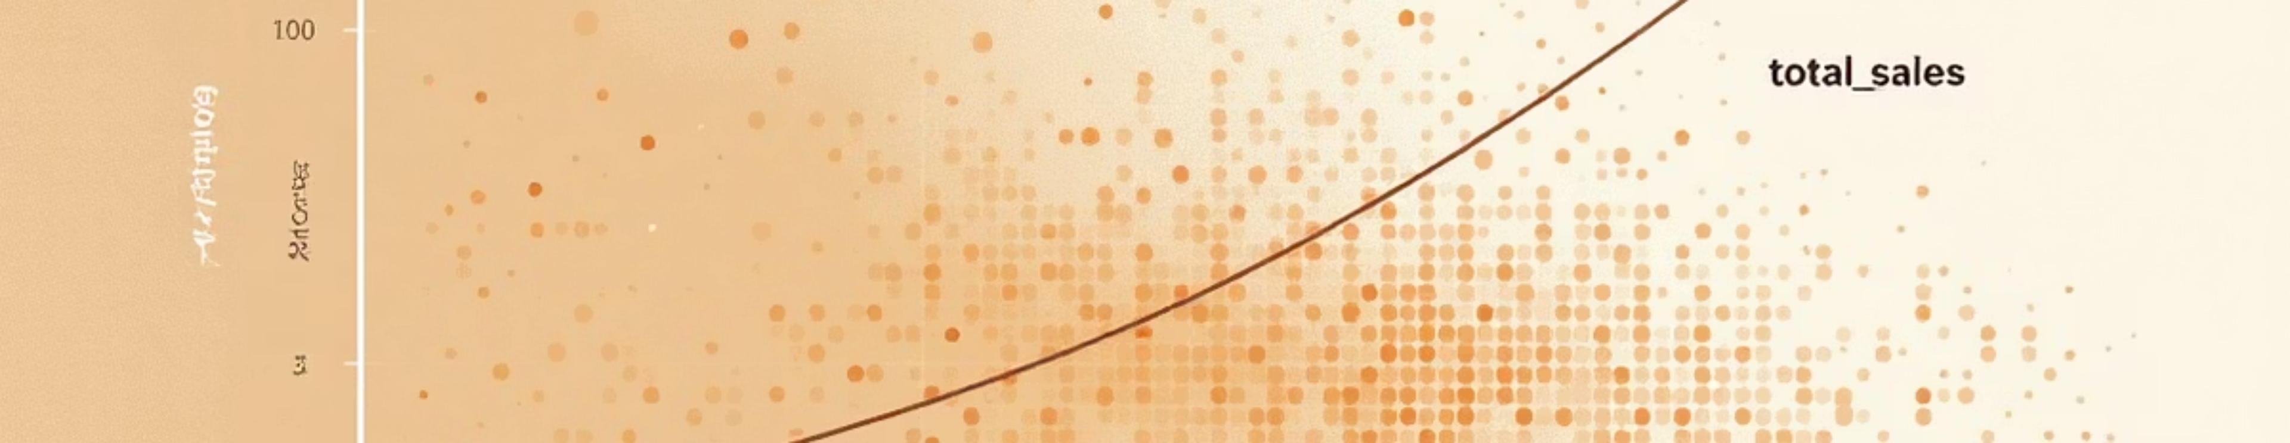
📢 Player Engagement
Relationship: ratings_count (player engagement) shows a stronger positive correlation with sales than the average rating score itself.
Insight: Games with extremely high sales typically have a much larger number of user ratings, indicating high player interest and community buzz is a better indicator of commercial success than a subjective score. * Correlation Matrix Summary: The heatmap confirms that ratings metrics have weak correlations with sales, while regional sales are, as expected, strongly correlated with total_sales.

Slide 8
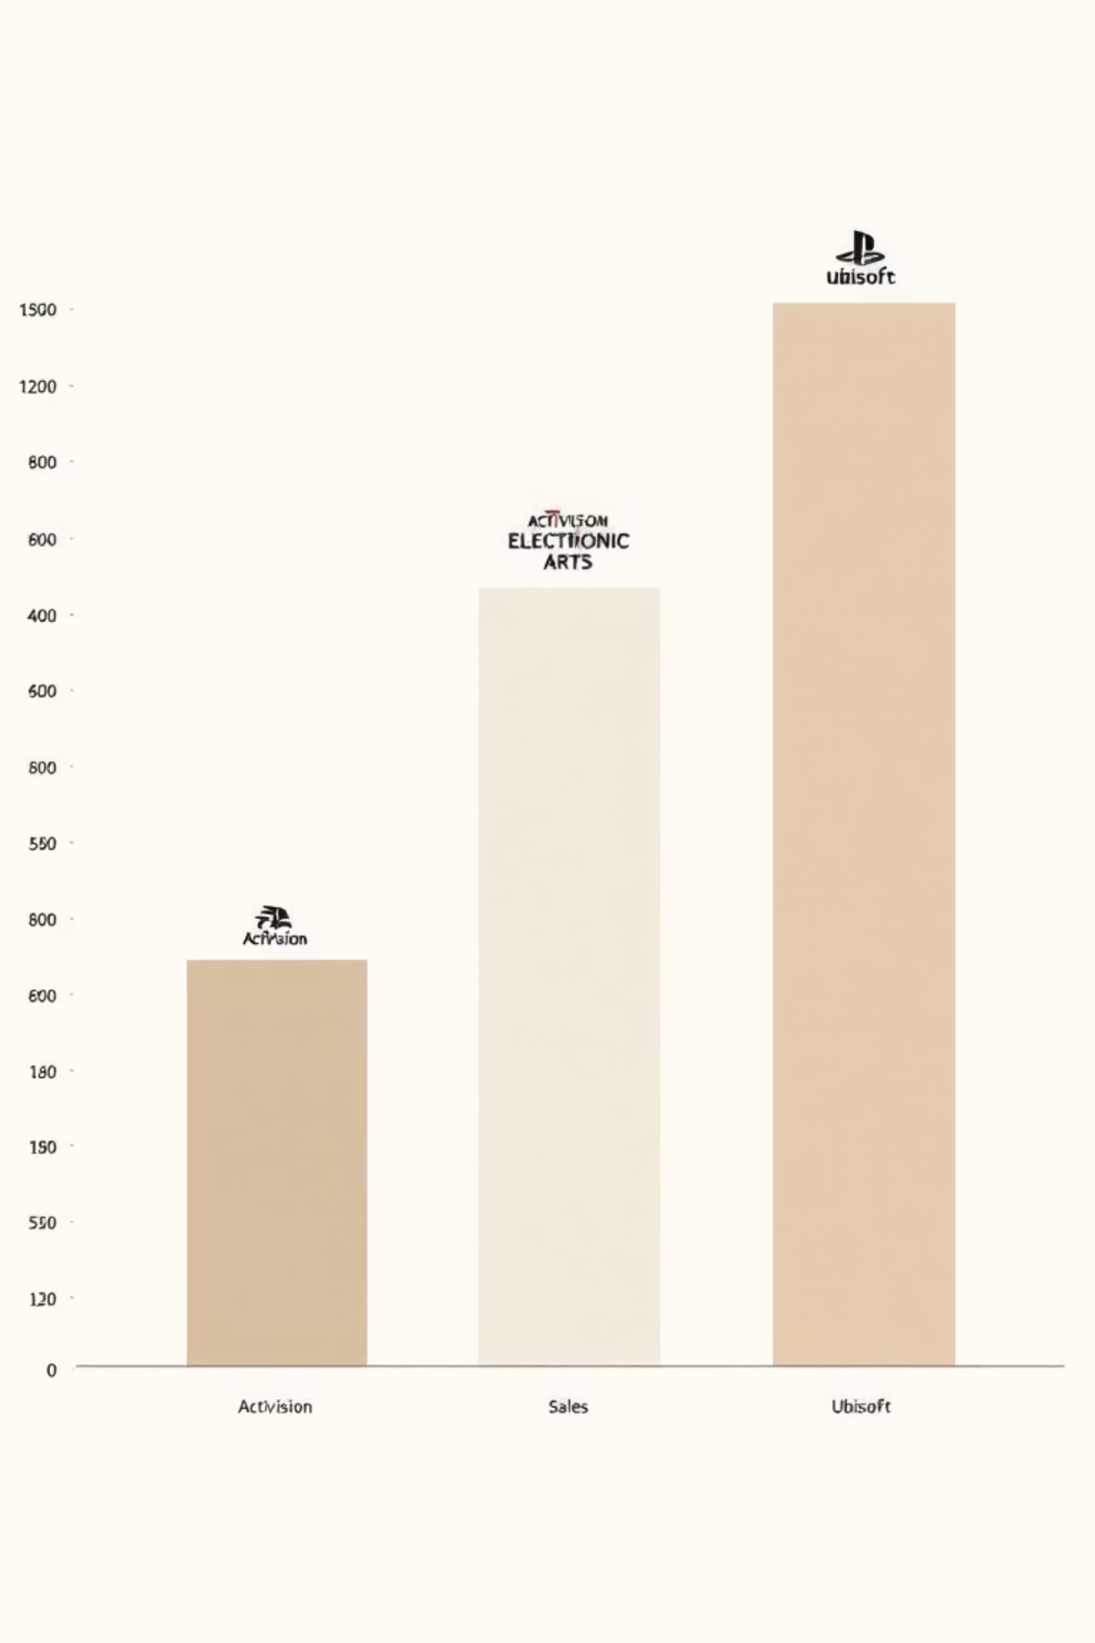
. Top Publishers
Key Players:
1
2
Activision
Electronic Arts (EA)
Leads the market (primarily due to the Call of Duty franchise).
Is a close second.
3
Ubisoft
Followed by Ubisoft.
Insight: Revenue is heavily concentrated among a few major third-party publishers with strong, established franchises. First-party Sony studios are also major players.

Slide 9
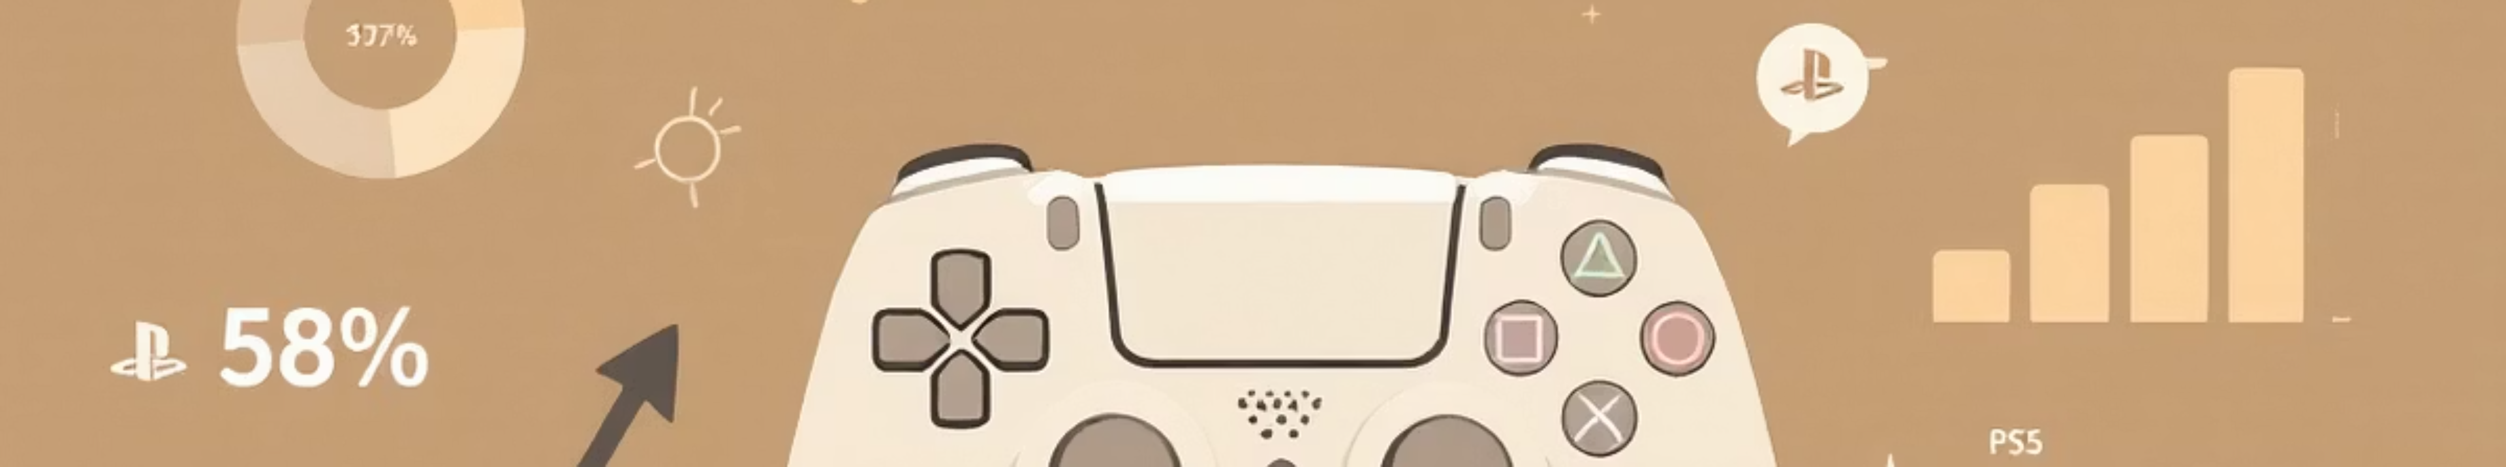
. Conclusion & Limitations
Overall Conclusion: Commercial success on PlayStation is less dependent on high user/critic ratings and more driven by strong franchise power, marketing, and high player engagement (as shown by ratings count). The PS4 era was the commercial peak represented in this dataset, with North America being the key revenue region.
Key Limitations (Important for the Evaluator):
PS5 Data Incompleteness: The project's accuracy for the latest generation is limited by missing/zero sales data for many PS5 titles.
Missing Metadata: The large number of "Unknown" genres and incomplete user ratings limits deep-dive insights.
Sales Granularity: The data is only annual, preventing analysis of month-to-month or seasonal sales trends.

